Slide 1
UNIT-V
Entrepreneurial Business Plan

Slide 2
Business Plan-Introduction
Business plan is a written statement of what an entrepreneur proposes to take up. It is a kind of guide for or course of action what the entrepreneur hopes to achieve in his business and how is he going to achieve it. In other words, business plan serves like a kind of big road map to reach the destination determined by the entrepreneur.

Slide 3
Business Plan-Definition
Mar J. Dollinger has defined the business plan as “the formal written expression of the entrepreneurial vision, describing the strategy and operations of the proposed venture.”
According to Jack M. Kaplan, “The term business plan means the development of a written document that spells out like a roadmap where you are, where you want to be, and how you want to get there.”

Slide 4
Preparation of Business Plan-Steps
Identify Business Idea
Market Research
Feasibility Analysis
Define Objectives
Develop Plan Components
Risk Assessment

Slide 5
Aspects to be Considered in Preparing Business Plan
Clarity of Business Idea
Market Potential
Financial Viability
Technical Feasibility
Legal Requirements
Competition Analysis
Risk Factors

Slide 6
Business Plan-Objectives
To give direction to the vision of entrepreneur
To objectively evaluate the future prospects of the business
To monitor the progress after implementation of the plan
To seek loans from financial institutions
To facilitate the decision making process
To persuade others to join the business
To identify strengths and weaknesses present in the internal environment
To identify opportunities and threats in the external environment
To assess the feasibility of the business

Slide 7
Elements of Business Plan
Executive summary
Products and services
Market analysis
Marketing strategy
Financial planning
Budget

Slide 8
Manufacturing and Operations Plan
The manufacturing and operations plan needs to include such factors as plant location, the type of facilities needed, space requirements, capital equipment requirements, and labor force (both full- and part-time) requirements. A service business may require particular attention to location (proximity to customers is generally a must), minimizing overhead, and obtaining competitive productivity from a labor force.

Slide 9
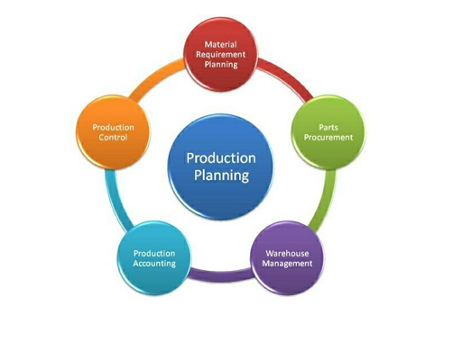
Production Planning
According to Ray Wild, production planning is defined as :
"Production Planning is concerned with the determination, acquisition and arrangement of all facilities necessary for future operations.“

Slide 10
Objectives of Production Planning
Effective utilization of resources
Steady flow of production
Estimate the resources
Ensures optimum inventory
Coordinates activities of departments
Minimize wastage of raw materials
Improves the labor productivity
Helps to capture the market
Provides a better work environment:
Facilitates quality improvement
Reduces the production costs

Slide 11
Risk Assessment in Entrepreneurship
Every business involves uncertainty. An entrepreneur may face problems like lack of funds, competition, or changing customer needs. These uncertainties are called risks. To handle them effectively, entrepreneurs use risk assessment, which helps in identifying, analyzing, and managing risks.
Risk Assessment is the process of:
Identifying potential risks
Analyzing their impact
Developing strategies to minimize or manage them

Slide 12
Importance of Risk Assessment
Reduces Uncertainty
Improves Decision-Making
Prevents Losses
Enhances Business Stability
Increases Chances of Success

Slide 13
Steps in Risk Assessment
Identify Risks
Analyze Risks
Evaluate Risks
Develop Risk Mitigation Strategies
Monitor and Review

Slide 14
Types of Risks in Entrepreneurship
Market Risk
Financial Risk
Operational Risk
Technological Risk
Legal Risk
Competitive Risk

Slide 15
Risk Assessment Techniques
SWOT Analysis
Risk Matrix
Sensitivity Analysis
Scenario Analysis

Slide 16
Risk Mitigation Strategies
Avoid Risk
Reduce Risk
Transfer Risk
Accept Risk

Slide 17
Role of Risk Assessment in Entrepreneurial Success
Helps in strategic planning
Builds confidence among investors
Ensures sustainable growth
Enables quick response to problems

Slide 18
Case Study

